Slide 1
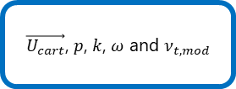


RANS Simulation
SIMPLE solver
$\vec{U_{cart}}$, $p$, $k$, $ω$ and $ν_{t,mod}$
Dataset pre-processing and features selection
MLP creation and optimization
MLP model for turbulent viscosity correction
$\vec{U_{LES,mean}}$ and $p_{LES, mean}$
Cylindrical coordinates projection
Target function definition $ν_{t_{corrected}} −ν_{sgs})$
LES Simulation
Dataset scaling
Optuna optimization
Input
Output
Transport and turbulence calculation
Clustering and scaler model
Layers
Centroid distance in features space and clusters ID results
Model training and validation

Slide 2
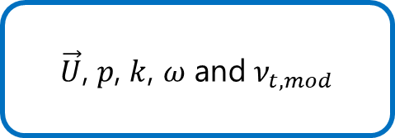

RANS Simulation
SIMPLE solver
$\vec{U}$, $p$, $k$, $ω$ and $ν_{t,mod}$
Clustering pipeline
Clustering labels and model
Features preprocessing
LES Simulation
$\vec{U_{LES,mean}}$ and $p_{LES, mean}$
Features selection
Transport and turbulence calculation
Hyperparameter setting
Model train

Slide 3

RANS Simulation
MLP creation and optimization
MLP model
LES Simulation
Target function definition $min Δν=ν_{t,mod} −ν_{t,eq}$
Clustering labels and model
Optuna optimization
Model training and validation

Slide 4


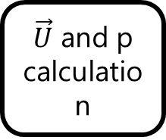




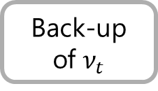
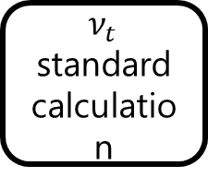
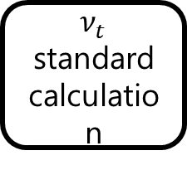


PIMPLE solver in RANS k-$ω$-SST framework
Back-up of $ν_{t}$
Back-up of $ν_{t}$
$\vec{U}$ and p calculation
k-$ω$ calculation
$ν_{t}$ standard calculation
Clustering analysis
MLP regression
$$ν_{t_{ML}}$$
$\vec{U}$ and p calculation
k-$ω$ calculation
$ν_{t}$ standard calculation
Clustering analysis
MLP regression
$$ν_{t_{ML}}$$
Iteration i
Discharge of $ν_{t_{ML}}$
Standard PIMPLE solver
I/O operations
MLP operations
Clustering Operations
Iteration i+1

